Slide 1

AI Based model for hospital management system
SRM INSTITUTE OF SCIENCE AND TECHNOLOGY
SCHOOL OF COMPUTING
DEPARTMENT OF COMPUTING TECHNOLOGIES
18CSP107L / 18CSP108L - MINOR PROJECT / INTERNSHIP
Batch ID: B063
Student 1 Reg. No: RA2011003010371
Student 1 Name: Debosmita Sarkar
Student 2 Reg. No: RA2011003010233
Student 2 Name: Aarya Pillai
Guide name: Dr. P. Velmurugan
Designation: Assistant Professor Department: Department of Computing Technologies

Slide 2
ABSTRACT
The healthcare industry is currently in the midst of a profound transformation, driven by rapid technological advancements. Our project, titled "AI-Based Model for Hospital Management System," stands at the forefront of this transformation, harnessing cutting-edge technologies to significantly enhance the patient experience. At its core, the project utilizes the power of Natural Language Processing (NLP), enabling the Chabot to not only understand but also generate human-like interactions. This advancement in NLP empowers the Chabot to revolutionize patient interactions within the hospital setting. In addition, our project leverages the capabilities of Large Language Models (LLMs), which have absorbed vast volumes of data, allowing them to decipher intricate linguistic patterns. As a result, the Chabot can deliver responses that are not just clear and contextually relevant but also personalized. LLMs exhibit remarkable versatility by accommodating an extensive range of topics and writing styles. This amalgamation of NLP and LLMs in our project has the potential to be a game-changer in healthcare management systems, promising to provide an elevated level of care and service to patients.

Slide 3
INTRODUCTION
The healthcare landscape, perpetually evolving and intricately intertwined with technological advancements, is undergoing a profound transformation. At the heart of this metamorphosis lies the imperative to optimize hospital management, a multifaceted endeavor critical to the delivery of efficient and patient-centric healthcare services. In response to this burgeoning need, this project introduces a pioneering solution - a Python-based Hospital Management chatbot. As the healthcare industry navigates the intricacies of modernization, the Hospital Management Chatbot emerges as a beacon of innovation. Leveraging the formidable capabilities of AI and natural language processing (NLP), this chatbot promises to redefine how hospitals operate, interact with patients, and manage their myriad of administrative tasks.

Slide 4
This project will unveil the intricate design, development, and implementation of this advanced chatbot, which aims to serve as an intelligent, adaptable, and user-centric interface for a diverse array of stakeholders within the healthcare ecosystem. From patients seeking appointments to medical practitioners accessing critical patient data, and from administrative personnel optimizing resource allocation to the broader community seeking health information, this chatbot is poised to revolutionize how we interact with healthcare institutions. This introduction sets the stage for a comprehensive exploration of the Hospital Management Chatbot's myriad functionalities, its pivotal role in streamlining hospital operations, and the transformative potential it holds for enhancing the overall patient experience.

Slide 5
PROBLEM STATEMENT
The healthcare industry is facing intense pressure to optimize hospital management processes, enhance patient experiences, etc. Currently, there are a lot of problems in the healthcare industry. Moreover, COVID-19 has emphasized the need for good solutions that reduce in-person interactions while maintaining high-quality care. Thus, there is a need for the development of a Hospital Management Chatbot using an LLM, which is capable of improving the current patient experience

Slide 6
OBJECTIVE
The primary objective of the chatbot is to improve patient experience and reduce administrative load to an extent. The chatbot has a user-friendly interface for patients, enabling them to access their doctor records and receive accurate health-related information. The goal is to empower patients to take control of their healthcare journey and help them better. The chatbot has developed advanced natural language processing (NLP) capabilities to enable the same to understand and respond effectively to a wide range of medical and non-medical queries.

Slide 7
METHODOLOGY
1. Model Selection and Fine-Tuning
For model selection and fine-tuning, the data is embedded using pre-trained models, specifically the "hkunlp/instructor-xl" model. This model is chosen for its ability to represent contextual relationships between words and its high performance on a variety of natural language processing (NLP) tasks.
2. User Flow Design
A user flow is designed for effective guidance, user-friendly error messages are crafted, and error recovery mechanisms are implemented to maintain context in case of issues. The user flow is designed to be simple and intuitive, with clear instructions and helpful prompts.

Slide 8
3. Large Language Model (LLM) Selection and Integration
LLMs, such as ChatGPT, are employed for their adaptability, contextual understanding, and generative capabilities, enabling a wide range of language-related tasks. ChatGPT is a large language model chatbot developed by OpenAI. It is trained on a massive dataset of text and code, and can generate text, translate languages, write different kinds of creative content, and answer your questions in an informative way.

Slide 9
4. User Interface Design
User interface (UI) design involves structuring the HTML document with semantic tags for accessibility and SEO. Semantic tags are used to provide context and meaning to the content of the web page, which is important for both accessibility and SEO. CSS is applied to create a visually appealing and responsive chatbot interface, distinguishing user and bot messages. CSS is a cascading style sheet language that is used to control the appearance of web pages. It can be used to style the chatbot interface, including the font, color, and layout of the messages.
04-11-2023

Slide 10
5. Creating test cases
Test cases can be created to test the chatbot's responses to a variety of queries and ensure that it is performing as expected.
6. Providing user instructions
Users should be provided with clear instructions on how to use the chatbot and what to expect from it. This will help to ensure that users have a positive experience with the chatbot.

Slide 11
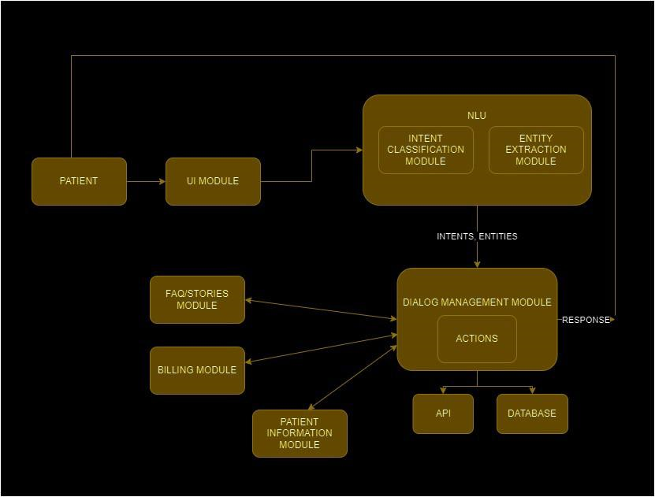
ARCHITECTURE DIAGRAM OF THE PROPOSED MODEL
04-11-2023

Slide 12
MODULES DESCRIPTION
User Interface Module
This module serves as the user's gateway to interact with the chatbot. It provides an intuitive interface accessible through web application.
FAQs Module
This module serves as a repository of accurate and up-to-date health information, offering answers to frequently asked medical questions. It empowers patients to make informed decisions about their health and well-being.

Slide 13
PDF text extraction Module: In this module, the data from the PDF provided is extracted .
Natural Language Processing (NLP) Module:
The NLP module employs advanced algorithms to understand user queries in natural language. It enables contextually relevant responses and continuously learns and adapts to improve language understanding.

Slide 14
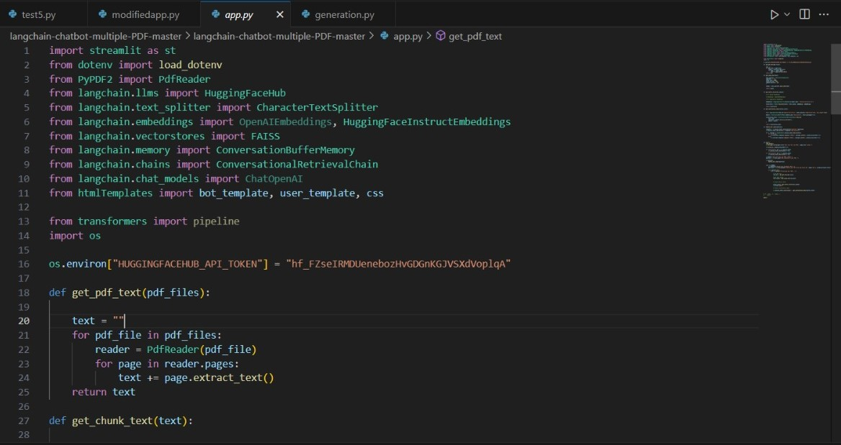
IMPLEMENTATION

Slide 15
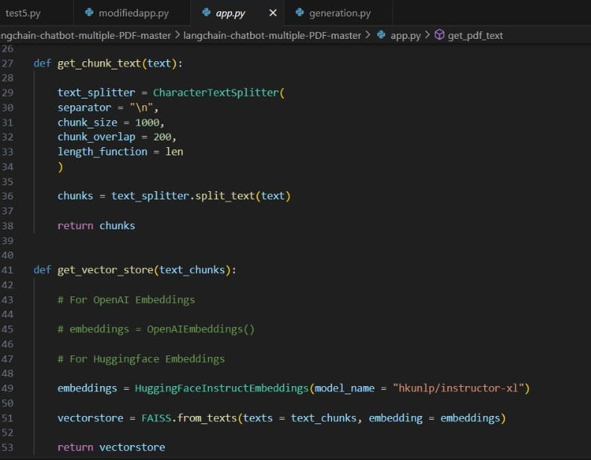

Slide 16
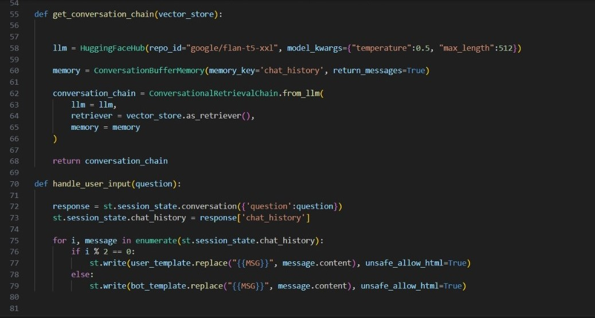

Slide 17
RESULTS
AND DISCUSSION
Artificial intelligence (AI)-based chatbots are rapidly gaining traction in the healthcare sector, with a wide range of potential applications in hospital management. From providing patients with information and support to automating tasks for healthcare professionals, AI chatbots have the potential to revolutionize the way hospitals operate.
One of the most significant advantages of AI chatbots is their ability to understand and respond to a wide variety of user queries. By leveraging large language models (LLMs), AI chatbots can be trained on massive datasets of text and code, which allows them to learn the nuances of human language and develop the ability to understand complex queries.

Slide 18
AI chatbots can also be used to provide patients with personalized recommendations for doctors and other healthcare providers. By analyzing patient data such as medical history, symptoms, and treatment preferences, AI chatbots can identify doctors who are well-suited to meet the patient's individual needs.
Overall, AI-based chatbots have the potential to be a game-changer in hospital management. By providing accurate and timely information and support to patients and healthcare professionals, AI chatbots can help to improve the quality and efficiency of healthcare delivery.

Slide 19
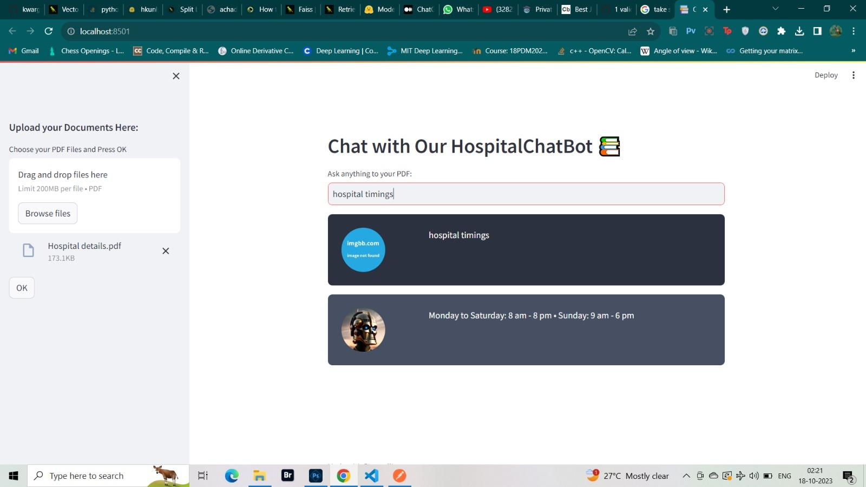
OUTPUT SCREENSHOTS

Slide 20
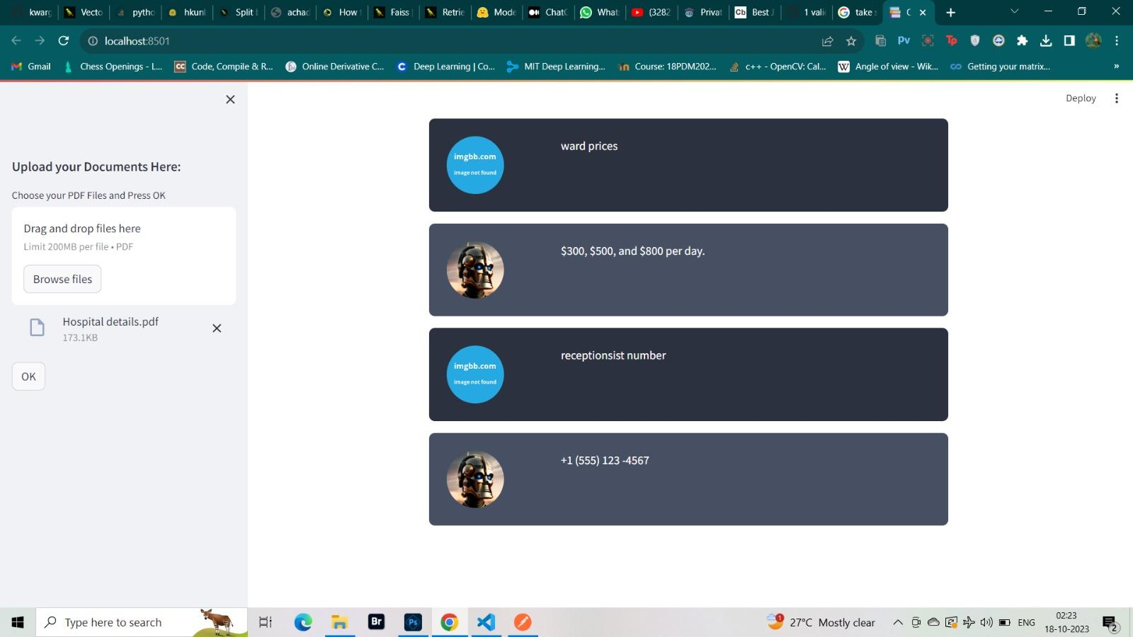

Slide 21
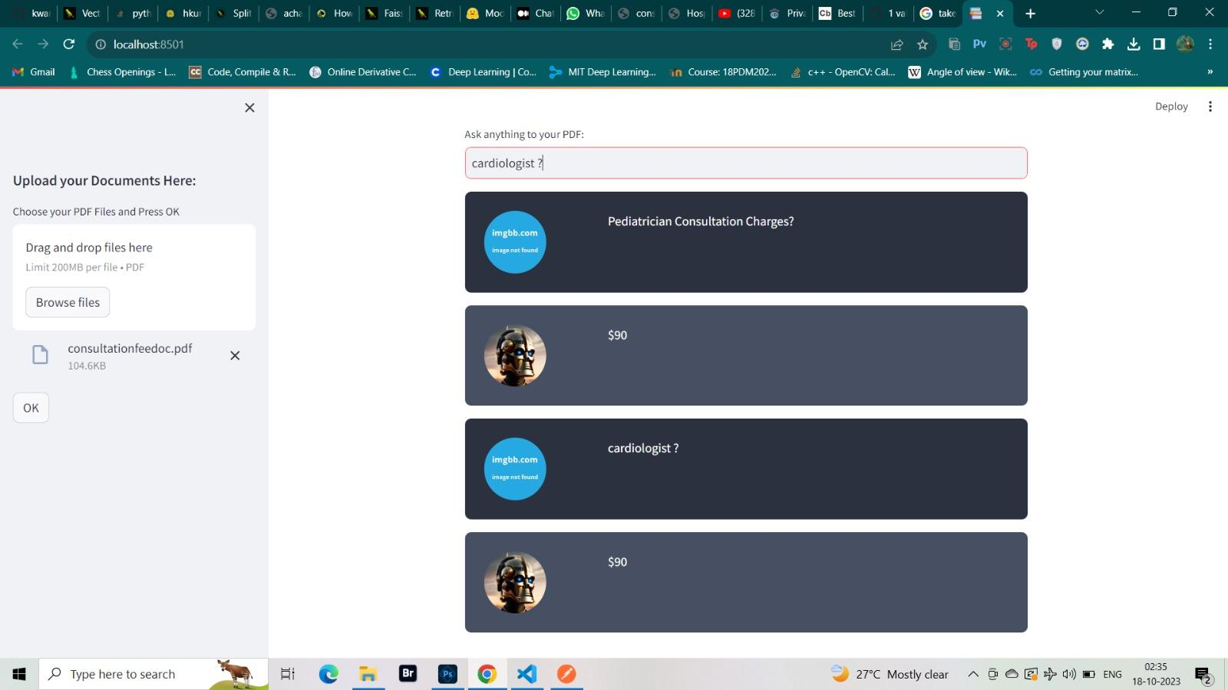

Slide 22
REFERENCES
[1] S. Gilbert, H. Harvey, T. Melvin, “Large language model AI chatbots require approval as medical devices”, Nature Medicine, pp 2396–2398, 2023
[2] Mittal M, Battineni G, Singh D, Nagarwal T, Yadav P, “Web-based chatbot for frequently asked queries (FAQ) in hospitals”, Journal of Taibah University Medical Sciences, pp 740-746, 2021
[3] Y. Lappalainen, N. Narayanan, “Aisha: A Custom AI Library Chatbot Using the ChatGPT API”, Journal of Web Librarianship, pp 37-58, 2023
[4] A. Hamidi, K. Roberts, “Evaluation of AI Chatbots for Patient-Specific EHR Questions”, Nature Medicine, pp 5-7, 2023
[5] E. Adamopoulou, L. Moussiades, “An Overview of Chatbot Technology”, Springer, vol. 584, 2020

Slide 23
[6] Lalwani T, Bhalotia S, Pal A, Rathod V, Bisen S, “Implementation of a Chatbot System using AI and NLP”, International Journal of Innovative Research in Computer Science & Technology (IJIRCST) vol. 6, pp 2-4,2018
[7] Hossain MM, Pillai SK, Dansy SE, Bilong AA, Panessai IY, “Mr. Dr. Health-Assistant Chatbot”, International Journal of Artificial Intelligence”, vol. 8 no. 2, pp 58-73, 2021
[8] Angappan AK, Khan NJ, Sharan M, Ahamed SF, “AI-based healthcare chatbot system”, Nature, pp 14-20, 2021
[9] Prasetio FA, “Chatbot In The Selection Of Outpatient Ward In Hospital”, pp 2094-2097, 2022
[10] R. B. Mathew, S. Varghese, S. E. Joy and S. S. Alex, "Chatbot for Disease Prediction and Treatment Recommendation using Machine Learning," 2019 3rd International Conference on Trends in Electronics and Informatics (ICOEI), Tirunelveli, India, 2019, pp 851-856

Slide 24
Thank you

